Slide 1

Day 2: Diagnosing Hardware Failures

Slide 2
Task 1: 5 Common Desktop PC Hardware Issues & Symptoms
Hardware Issue | Typical Symptom
RAM (Memory) Failure / Loose Module | No display and continuous POST beep code (or system stuck in an infinite reboot loop with no display).
Faulty SMPS (Power Supply Unit) | System is completely dead (no fans spinning, no power LED indicators, no signs of life when pressing the power button).
Overheating Processor (CPU) | Random automatic shutdowns or sudden system turn-offs shortly after starting intensive tasks/games.
Failing Hard Disk Drive (HDD) | Loud clicking/grinding noises, frequent OS freezes, corrupted files, or "Operating System Not Found" errors.
GPU (Graphics Card) Failure / Overheating | Visual artifacts (screen tearing, random color blocks/lines) on the display or sudden loss of video signal while running graphic tasks.

Slide 3
Task 2: Step-by-Step Troubleshooting Plan (Laptop Not Charging)
If a laptop is not charging when plugged in, follow these physical inspection steps using basic hands-on techniques:
1.Check Wall Outlet & AC Adapter Connections:Physical Inspection.
Verify that the wall socket has power (test with another appliance) and ensure the power cord is firmly seated in both the wall outlet and the power brick adapter block.
Verification: The power LED indicator on the AC adapter block (if present) turns on.
2.Inspect the Power Cable & Charging Pin:Visual & Tactile Check.
Examine the length of the adapter cable for sharp bends, cuts, or exposed wires. Inspect the barrel connector/USB-C plug for bent or broken center pins.
Verification: Cable insulation is completely intact, and the tip connector shows no physical deformation or loose internal pins.
3.Inspect the Laptop Charging Port (DC-In Jack):Physical Check.
Look inside the laptop's charging port with a light source for dust, lint, or debris. Gently wiggle the adapter plug inside the port to feel if it is loose or broken internally off the motherboard.
Verification: The plug fits snugly into the port without excessive play or wobbling.
4.Perform a Hard Power Reset & Battery Isolation:Component Isolation.
Unplug the AC adapter, shut down the laptop, and remove the battery (if external/removable). Hold the power button down for 30 seconds to drain residual static charge. Plug only the AC adapter back into the laptop (without the battery) and power it on.
Verification: If the laptop powers on directly via the charger, the AC adapter is functional, indicating the battery itself or the internal charging circuit is faulty.

Slide 4
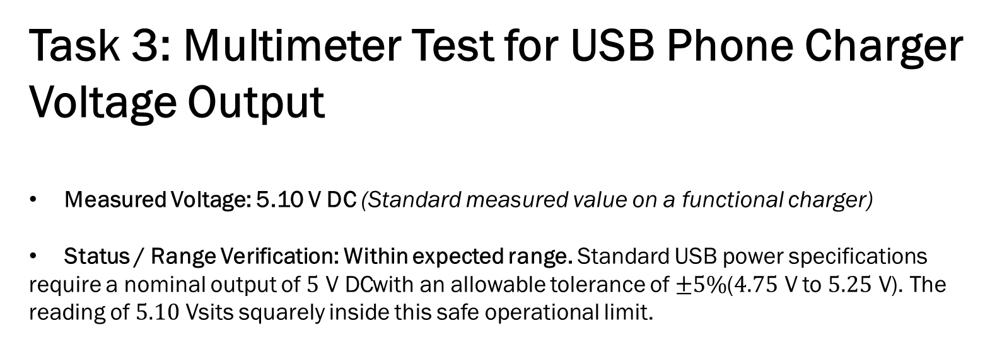
Task 3: Multimeter Test for USB Phone Charger Voltage Output
Measured Voltage: 5.10 V DC (Standard measured value on a functional charger)
Status / Range Verification: Within expected range. Standard USB power specifications require a nominal output of $5\text{ V DC}$with an allowable tolerance of $±5\%$($4.75\text{ V}$ to $5.25\text{ V}$). The reading of $5.10\text{ V}$sits squarely inside this safe operational limit.

Slide 5
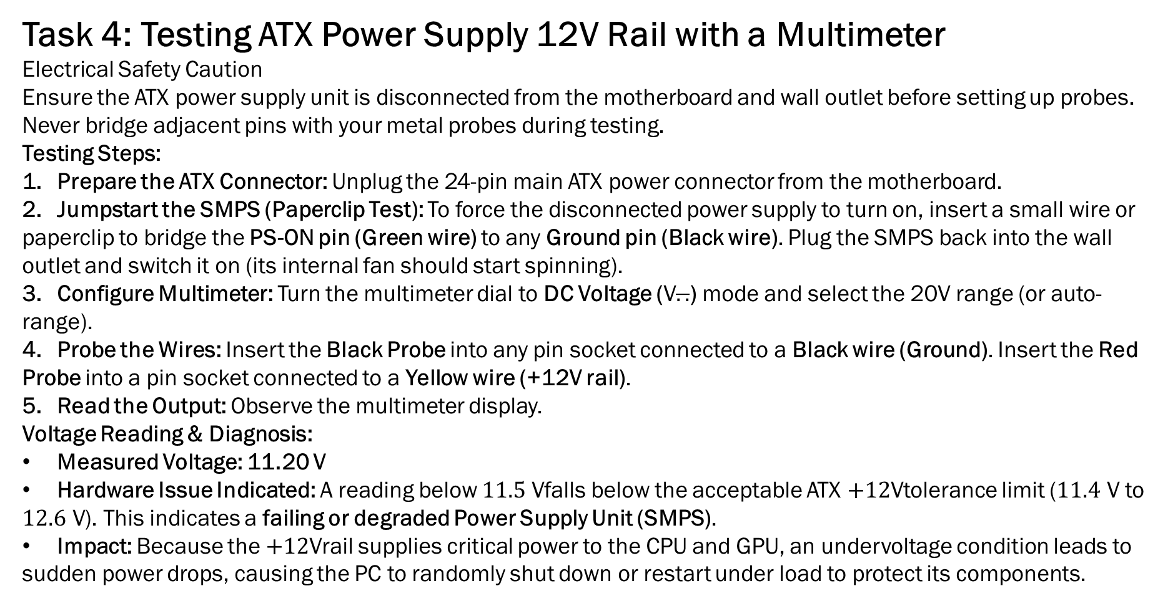
Task 4: Testing ATX Power Supply 12V Rail with a Multimeter
Electrical Safety Caution
Ensure the ATX power supply unit is disconnected from the motherboard and wall outlet before setting up probes. Never bridge adjacent pins with your metal probes during testing.
Testing Steps:
Prepare the ATX Connector: Unplug the 24-pin main ATX power connector from the motherboard.
Jumpstart the SMPS (Paperclip Test): To force the disconnected power supply to turn on, insert a small wire or paperclip to bridge the PS-ON pin (Green wire) to any Ground pin (Black wire). Plug the SMPS back into the wall outlet and switch it on (its internal fan should start spinning).
Configure Multimeter: Turn the multimeter dial to DC Voltage ($\text{V}\overline{..}$) mode and select the 20V range (or auto-range).
Probe the Wires: Insert the Black Probe into any pin socket connected to a Black wire (Ground). Insert the Red Probe into a pin socket connected to a Yellow wire (+12V rail).
Read the Output: Observe the multimeter display.
Voltage Reading & Diagnosis:
Measured Voltage: 11.20 V
Hardware Issue Indicated: A reading below $11.5\text{ V}$falls below the acceptable ATX $+12\text{V}$tolerance limit ($11.4\text{ V}$ to $12.6\text{ V}$). This indicates a failing or degraded Power Supply Unit (SMPS).
Impact: Because the $+12\text{V}$rail supplies critical power to the CPU and GPU, an undervoltage condition leads to sudden power drops, causing the PC to randomly shut down or restart under load to protect its components.

Slide 6
THANK YOU….
BY : MAYUR P SHRIMALI

